Slide 1


Debugging in C Language
Author: UmairSolangi

Slide 2



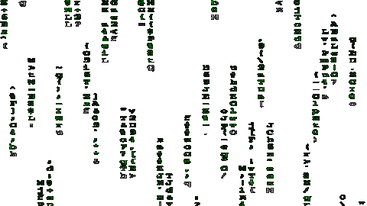
Index:
What is debugging?
How many types of error?
Explain the error types with example?
How to debug the program?

Slide 3


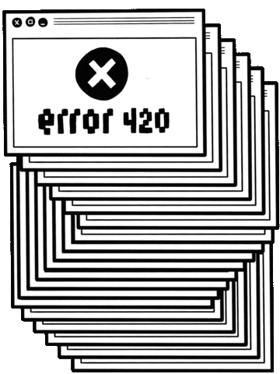

What is debugging?

Slide 4
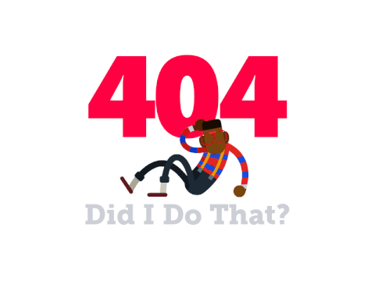
How many types of Error?
Syntax Error
Logical Error

Slide 5

Syntax Error:
Syntax errors: Errors that occur when you violate the rules of writing C

Slide 6
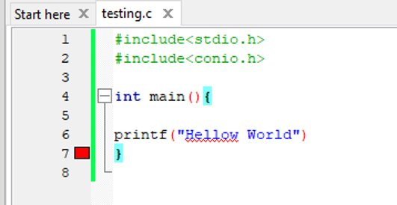
Syntax Error Example:

Slide 7

Logical Error:
It is a type of runtime error that may simply produce the wrong output

Slide 8
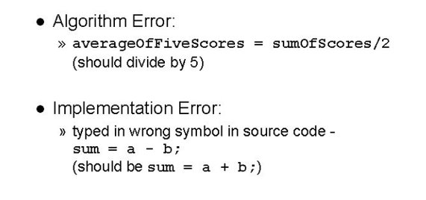
Logical Error Example:

Slide 9
How to debug the program?​
Identify the Error
Identify the Error Location
Analyze the Error
Apply the Fix and Text

Slide 10

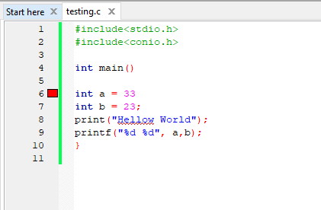
How to debug the program

Slide 11
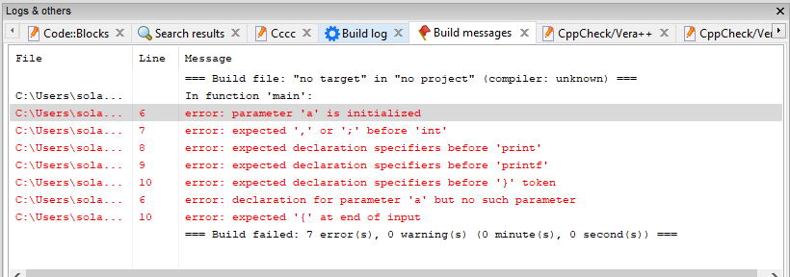
How to debug the program

Slide 12
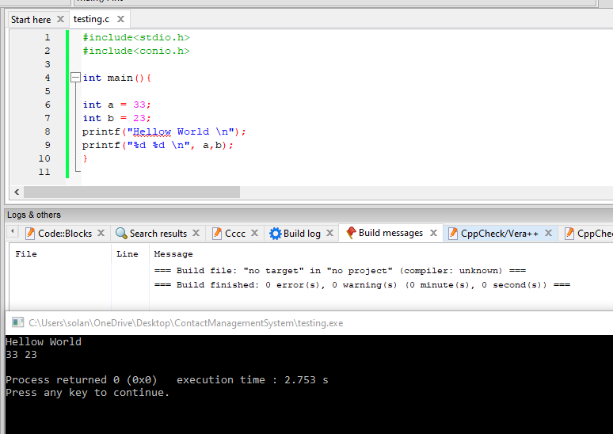
How to debug the program (Cont...)

Slide 13


